Slide 1
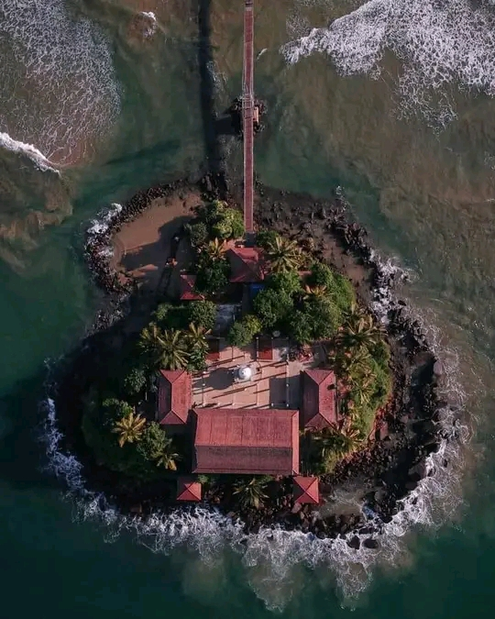
BEST TOURIST PLACES TO VISIT IN MATARA
BY :- D.A.THARUSHI HANSIKA
TAN/IT/2021/F/0070
HIGHER NATIONAL DIPLOMA IN INFORMATION TECHNOLOGY
ATI TANGALLE

Slide 2
CONTENT
Introduction.
Background.
Top Attractions in Matara.
Matara Attractions Information.
The best thins to do in Matara.
Frequently asked questions about Matara.
Benefits to the country due to tourism industry in Matara District.

Slide 3
Introduction
Matara sists along the South Coast of Sri Lanka about 140km from Colombo.This beautiful Sri Lankan Costal town is surrounded by a large number of tourist places,and some of them are popular one-day trip places in Sri Lanka. Rekawa Beach,Weligama,Mirissa Beach, Star Fort, Turtle bay, and Blowhole are some of the popular one-day tour places from Colombo.

Slide 4
Background
Matara is one of the largest cities in Southern Sri Lanka and a popular beach holiday destination in Sri Lanka. Matara has a fascinating, and long beach front locality but it is very less crowed compared to most beach resorts in Sri Lanka. Matara is a land mark included in many tours with Sri Lanka’s south coast.Matara is among the important cities that have every long history. The city has a collection of colonial building with fascinating architecture; these building add colonical charm to the city.

Slide 5
Top Attractions in Matara
Weligama Beach
Polhena Beach
Snake Farm
Hiriketiya Beach
Kushta Raja Gala
Weherahena Buddhist Temple
The Shrine Our Lady of Matara
Matara Beach
Star Fort
Tea House
Matara Paravi Duwa Temple
Medawatta Beach
Dondra Head Light house
Old Dutch Trade Center(Nupe Market)
Mirissa
Mangrove Forest Kirala Kele
Oliyagare Forest

Slide 6
Matara Attraction Information
Attraction :- 178
Number of Reviews :- 5749
Number of Photos :- 8,132
Local Time :- Friday 12:03 p.m.

Slide 7
The Best Things to Do in Matara
Tours
Outdoor Attractions
Boat tours & water sport
Adventure
Surfing , Windsurting & Kite surfing
Relaxing Attractions

Slide 8
Frequently Asked Questions about Matara
What are the top attraction to visit in Matara?
What are the best outdoor activities in Matara?
What are the best day trip from Matara?
What are the most popular things to do in Matara with kids?

Slide 9
Benefits to the country due to tourism industry in Matara District.
Tourism bring in money.
Getting more job opportunities.
Incentive to preserve the natural environment .
Helps to preserve culture and heritage.
Stimulates growth of a country.

Slide 10
Thank You!

